Slide 1
Deep Learning Training
Lecture 2: Deep Neural Network Structure and Optimization

Slide 2
Content
Biological Motivation
Artificial Neuron
Neural Network Structure
Deep Neural Network
Activation Functions
Sigmoid, Tanh, ReLU, Softmax
Importance of Bias
Loss function
Gradient Descent
Back-Propagation

Slide 3

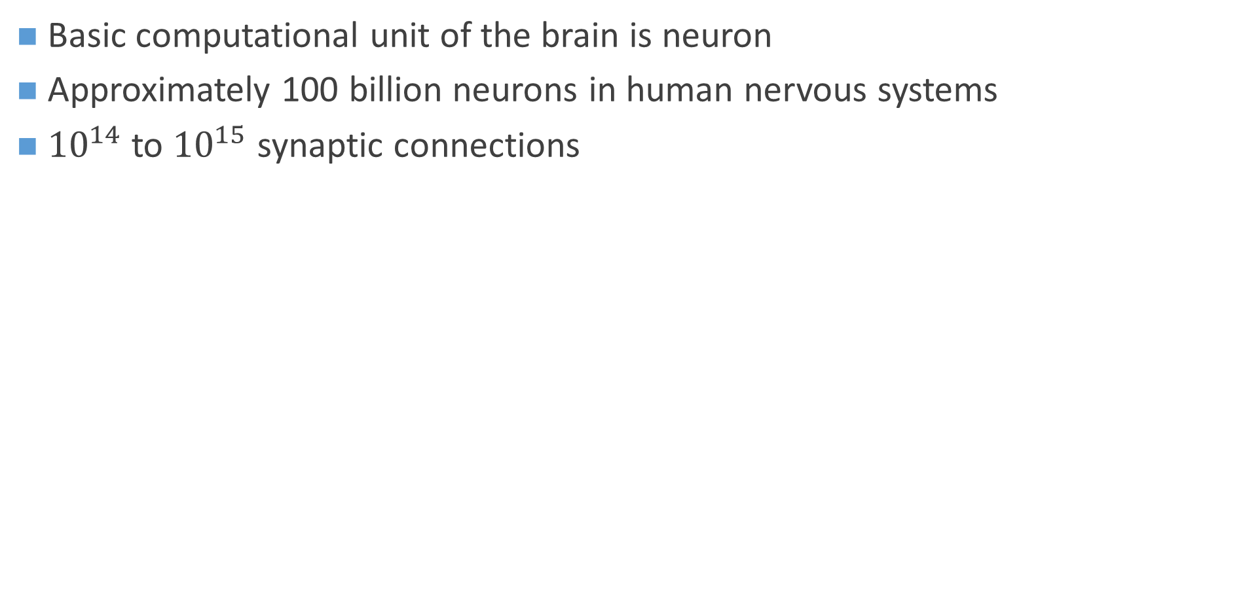
Biological Motivation
Basic computational unit of the brain is neuron
Approximately 100 billion neurons in human nervous systems
${10}^{14}$ to ${10}^{15}$ synaptic connections
Figure: Biological Neuron

Slide 4

Artificial Neuron
Simplified model of biological neurons
Figure: Mathematical model of neuron

Slide 5
Artificial Neuron: Difference from biological neurons
Dendrites in biological neuron perform complex nonlinear computations
Synapses are not just a single weight, they're a complex non-linear dynamical system
The exact timing of the output spikes in many systems is important but not taken into account in artificial neurons
Human brain typically has more neurons and connections than ANN.

Slide 6


Artificial Neural Network (Multilayer Perceptron)
Connection of neurons that are connected in an acyclic graph
Neurons are stacked in multiple layers
Consists of one input layer, one output layer and one or more hidden layers
Figure: (Left) A 2-layer neural network (Right) A 3-layer neural network

Slide 7
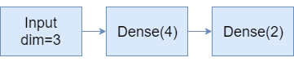
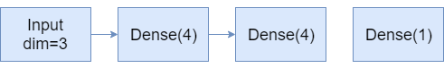
Neural Network: Parameter Count
Number of Neurons = 4+2=6
Weights = 3*4+4*2=20
Biases=4+2=6
Learnable parameters=20+6=26
Number of Neurons = 4+4+1=9
Weights = 3*4+4*4+4*1=32
Biases=4+4+1=9
Learnable parameters=32+9=41

Slide 8
Deep Neural Network
Simple feedforward neural network with 3 or more hidden layers
Neurons of adjacent layers are connected densely or sparsely
Neurons in same layer are not connected with each other
Representational power increases with increased depth and number of units in each layer
Why can’t we use arbitrarily large network?
Computational complexity
Optimizing issue
Overfitting

Slide 9
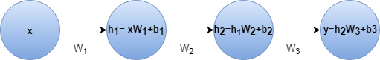
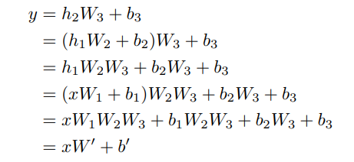
Activation Functions for Introducing non-linearity
A feedforward neural network with linear activation and any number of hidden layers is equivalent to just a linear neural network with no hidden layer.
Real world functions are highly non-linear

Slide 10
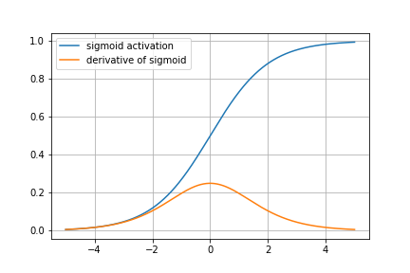
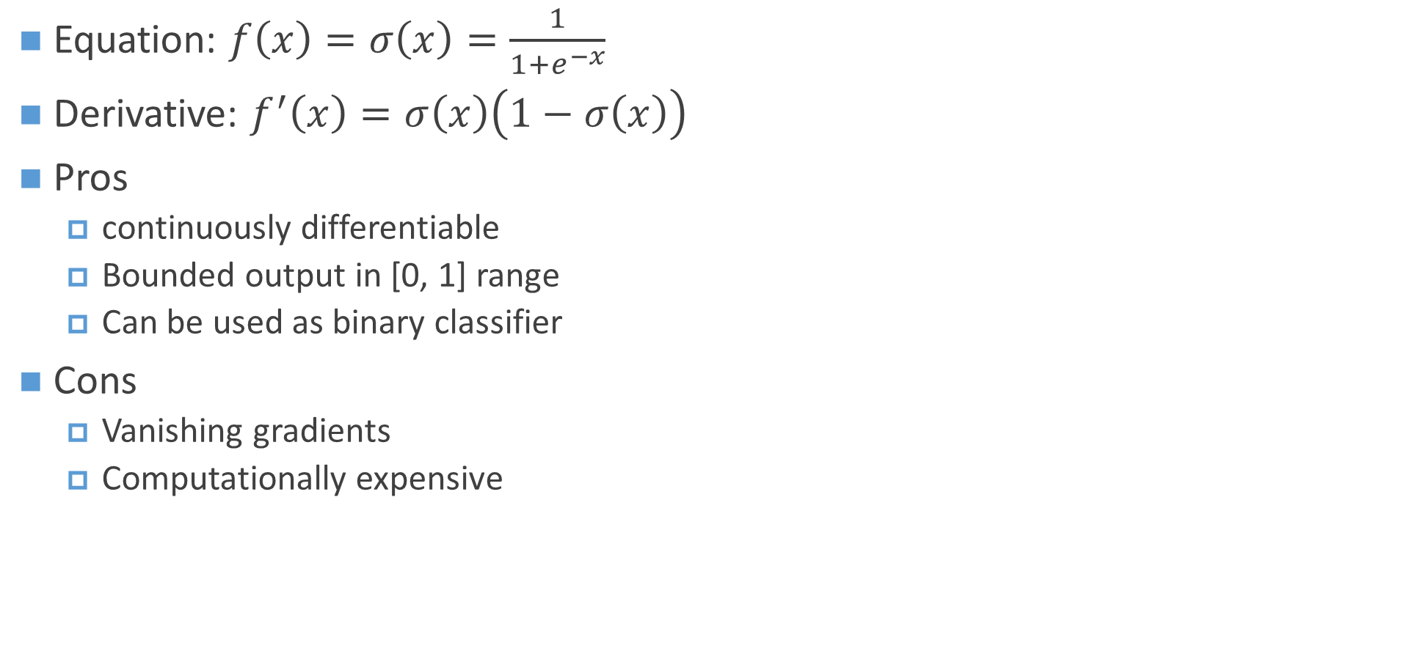
Activation Function: Sigmoid
Equation: $f\left(x\right)=σ\left(x\right)=\frac{1}{1+e^{−x}}$
Derivative: $f^{′}\left(x\right)=σ\left(x\right)\left(1−σ\left(x\right)\right)$
Pros
continuously differentiable
Bounded output in [0, 1] range
Can be used as binary classifier
Cons
Vanishing gradients
Computationally expensive

Slide 11
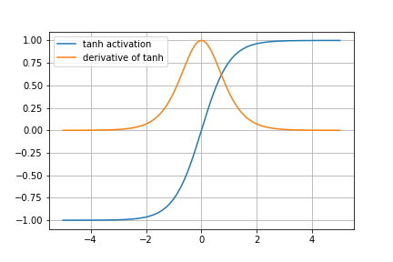
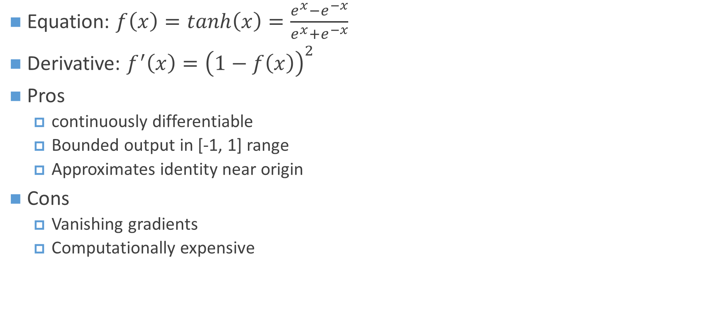
Activation Function: Tanh
Equation: $f\left(x\right)=tanh\left(x\right)=\frac{e^{x}−e^{−x}}{e^{x}+e^{−x}}$
Derivative: $f^{′}\left(x\right)={\left(1−f\left(x\right)\right)}^{2}$
Pros
continuously differentiable
Bounded output in [-1, 1] range
Approximates identity near origin
Cons
Vanishing gradients
Computationally expensive

Slide 12
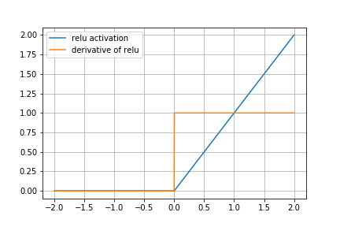
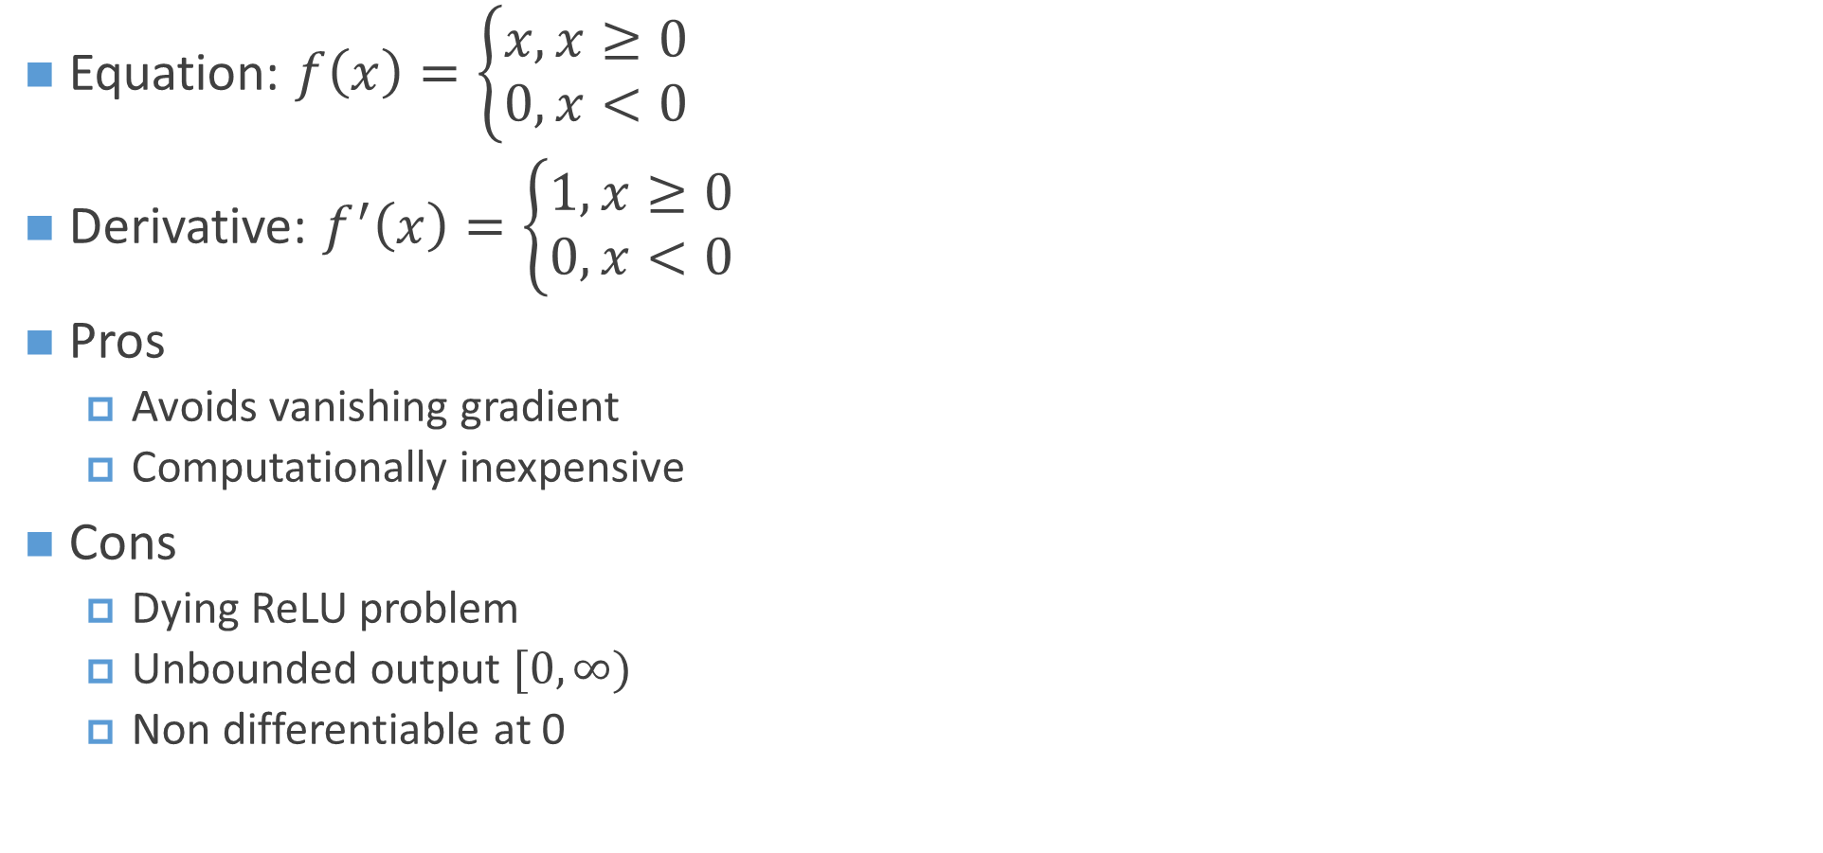
Activation Function: ReLU (Rectified Linear Unit)
Equation: $f\left(x\right)=\left\{\begin{aligned}x, x≥0 \\ 0, x<0\end{aligned}\right.$
Derivative: $f^{′}\left(x\right)=\left\{\begin{aligned}1, x≥0 \\ 0,x<0\end{aligned}\right.$
Pros
Avoids vanishing gradient
Computationally inexpensive
Cons
Dying ReLU problem
Unbounded output $[0, ∞)$
Non differentiable at 0

Slide 13
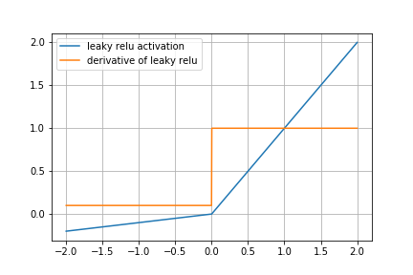
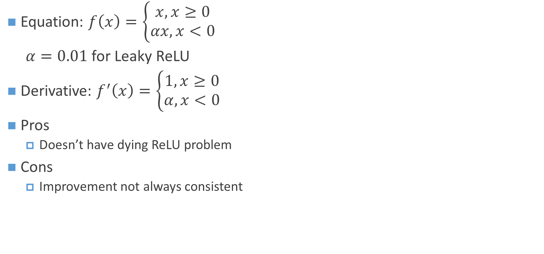
Activation Function: Leaky ReLU and Parametric ReLU
Equation: $f\left(x\right)=\left\{\begin{aligned}x, x≥0 \\ αx, x<0\end{aligned}\right.$
$α=0.01$for Leaky ReLU
Derivative: $f^{′}\left(x\right)=\left\{\begin{aligned}1, x≥0 \\ α,x<0\end{aligned}\right.$
Pros
Doesn’t have dying ReLU problem
Cons
Improvement not always consistent

Slide 14
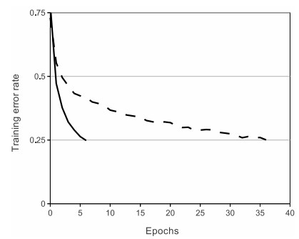
Activation function: What to choose
For training deep feedforward network ReLU is better
Sigmoid/Tanh are used in some gated units
Figure: ReLU (solid line) vs tanh neurons (dashed line) convergence rate (Krizhevsky et al.)

Slide 15
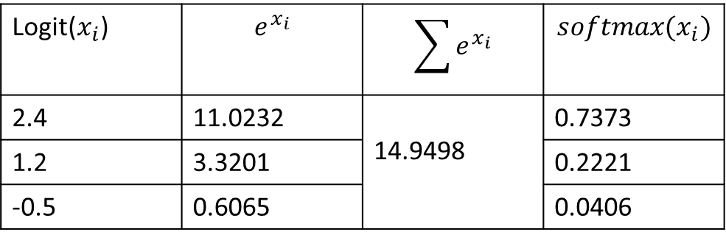
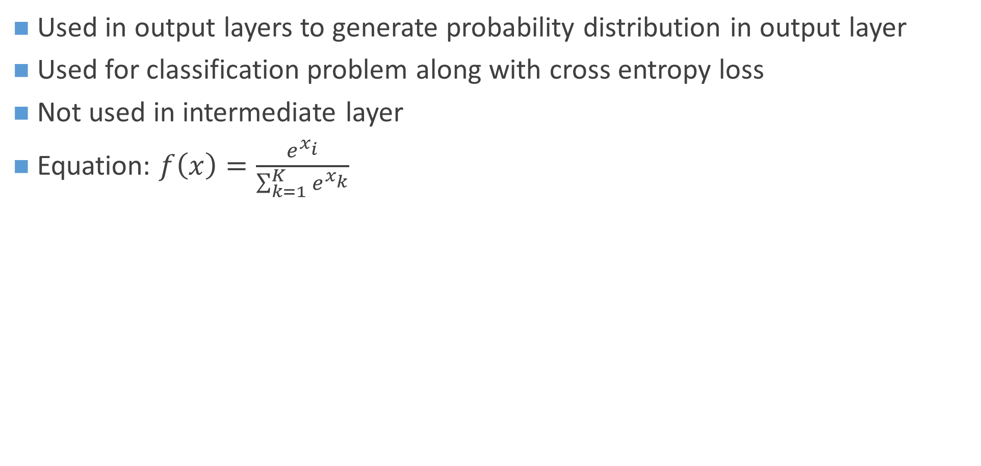
Softmax
Used in output layers to generate probability distribution in output layer
Used for classification problem along with cross entropy loss
Not used in intermediate layer
Equation: $f\left(x\right)=\frac{e^{x_{i}}}{\sum_{k=1}^{K}{e^{x_{k}}}}$
Logit($x_{i}$) | $$e^{x_{i}}$$ | $$\sum{e^{x_{i}}}$$ | $$softmax(x_{i})$$
2.4 | 11.0232 | 14.9498 | 0.7373
1.2 | 3.3201 |  | 0.2221
-0.5 | 0.6065 |  | 0.0406

Slide 16
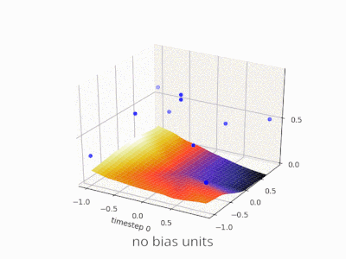
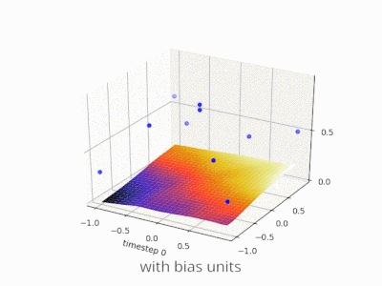
Importance of bias
Allows to shift the activation curve
Without bias term output will be zero if input is zero

Slide 17
Loss Function
Measures how well we can model the dataset
Predicted value close to actual value => low loss
Predicted value far off from actual value => high loss
Usually loss is always positive
Goal is to achieve minimum loss (zero)
https://pytorch.org/docs/stable/nn.html#loss-functions

Slide 18
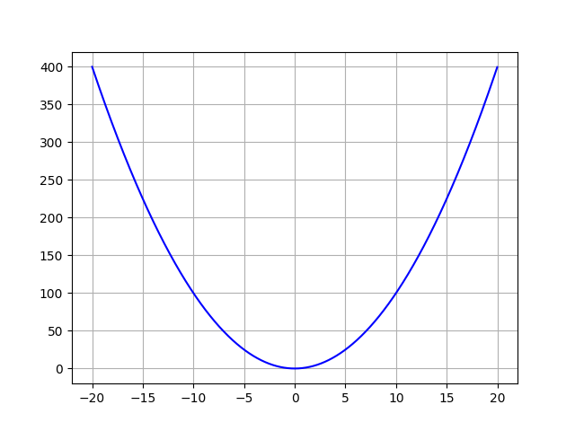
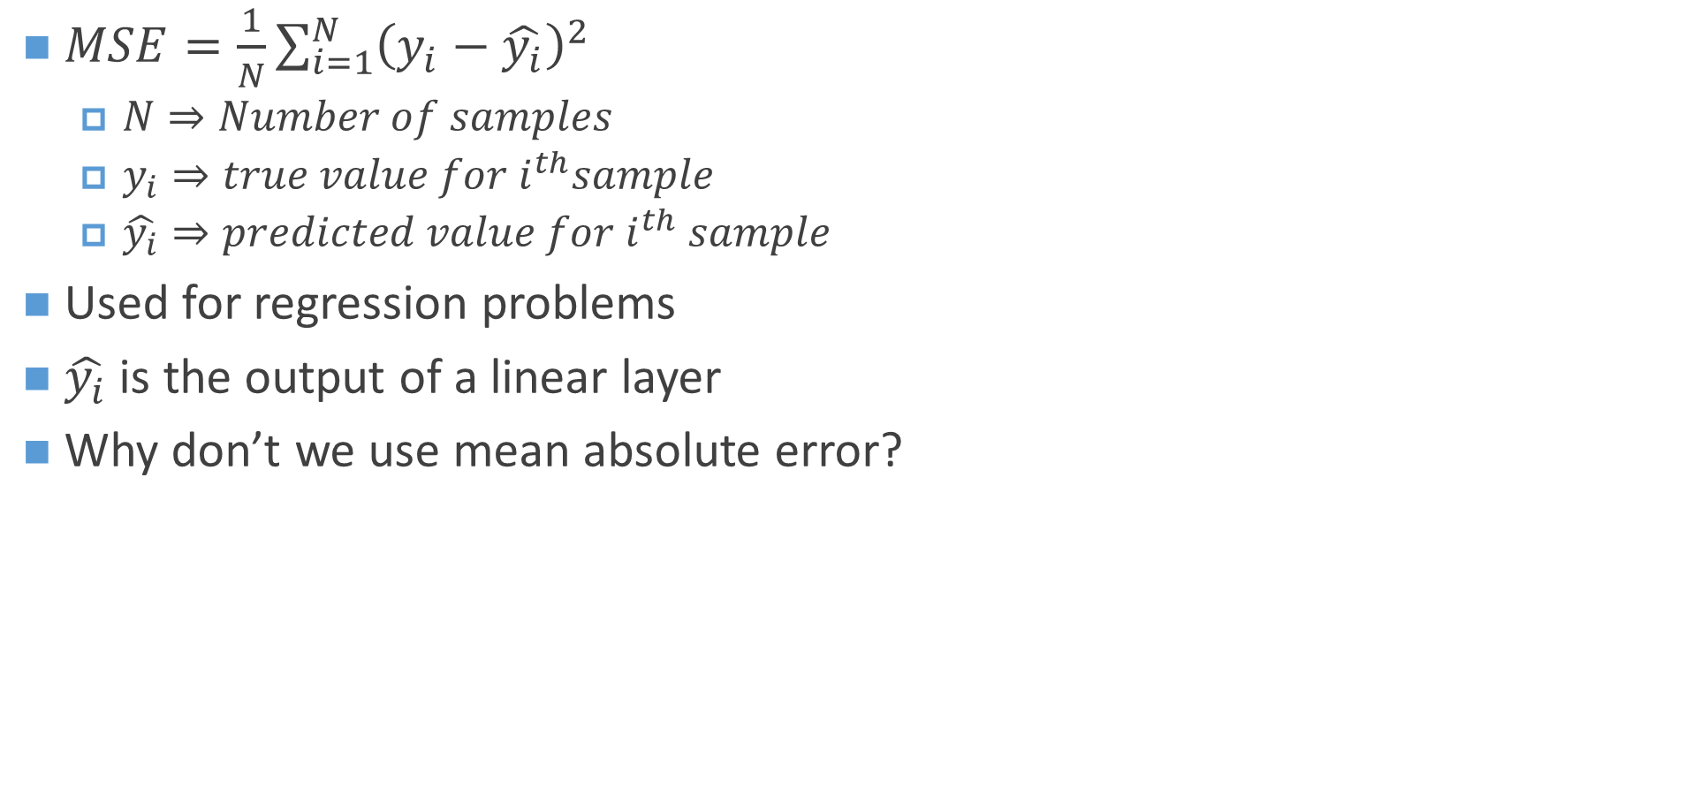
Mean Squared Loss
$MSE=\frac{1}{N}\sum_{i=1}^{N}{{\left(y_{i}−\hat{y_{i}}\right)}^{2}}$
$N⇒Number of samples$
$y_{i}⇒true value for i^{th}sample$
$\hat{y_{i}}⇒predicted value for i^{th} sample$
Used for regression problems
$\hat{y_{i}}$ is the output of a linear layer
Why don’t we use mean absolute error?

Slide 19
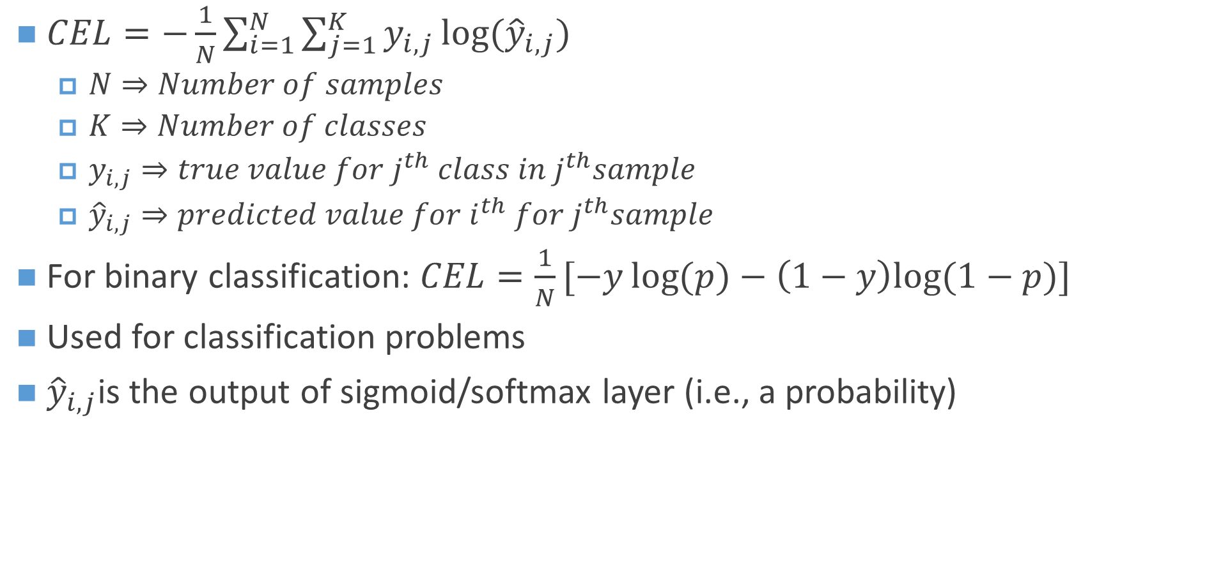
Cross Entropy Loss
$CEL=−\frac{1}{N}\sum_{i=1}^{N}{{\sum_{j=1}^{K}{y_{i,j}}log⁡({\hat{y}}_{i,j}) }_{ }}$
$N⇒Number of samples$
$K⇒Number of classes$
$y_{i,j}⇒true value for j^{th} class in j^{th}sample$
${\hat{y}}_{i,j}⇒predicted value for i^{th} for j^{th}sample$
For binary classification: $CEL=\frac{1}{N}[−y\log{(p)}−\left(1−y\right)log⁡(1−p)]$
Used for classification problems
${\hat{y}}_{i,j}$is the output of sigmoid/softmax layer (i.e., a probability)

Slide 20

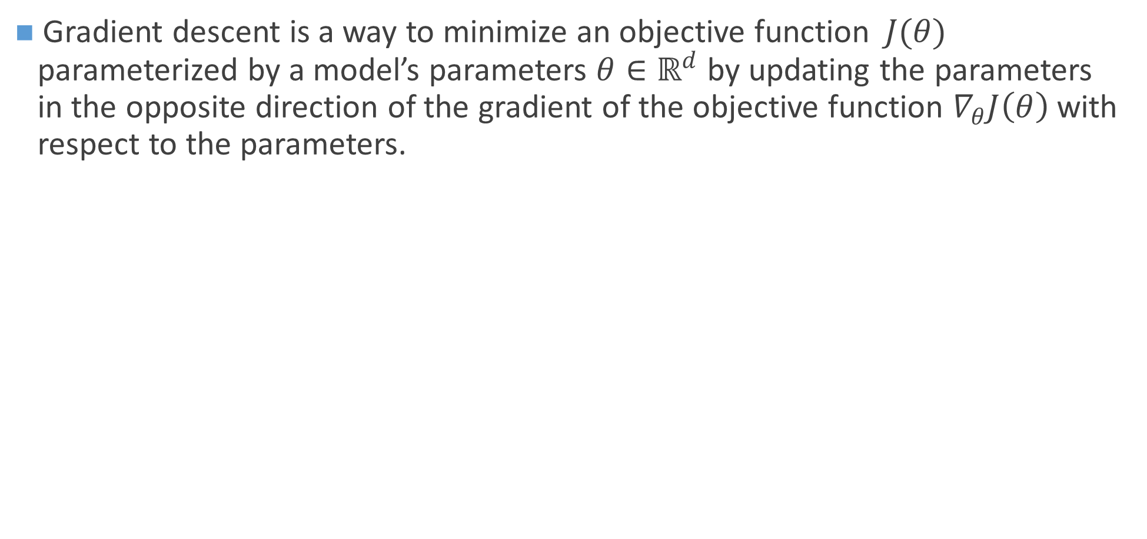
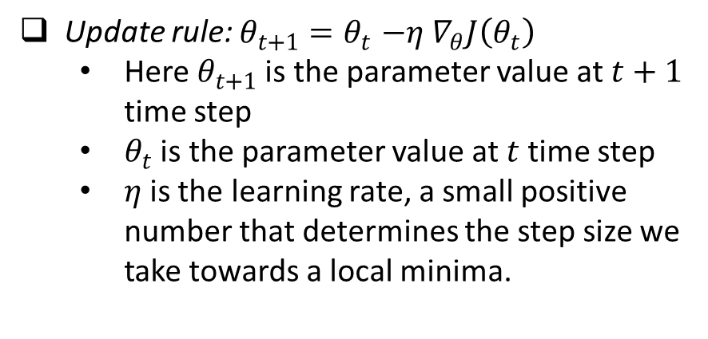
Gradient Descent
Gradient descent is a way to minimize an objective function$J(θ)$ parameterized by a model’s parameters $θ∈ℝ^{d}$ by updating the parameters in the opposite direction of the gradient of the objective function $∇_{θ}J\left(θ\right)$ with respect to the parameters.
Update rule: $θ_{t+1}{=θ}_{t}−η ∇_{θ}J\left(θ_{t}\right)$
Here $θ_{t+1}$is the parameter value at $t+1$ time step
$θ_{t}$ is the parameter value at$t$time step
$η$is the learning rate, a small positive number that determines the step size we take towards a local minima.

Slide 21

Gradient Descent Analogy
Analogous to climbing down a mountain in heavy fog
steepness of the hill => slope
Instrument to measure steepness => differentiation
Interval between measurement => Learning rate

Slide 22
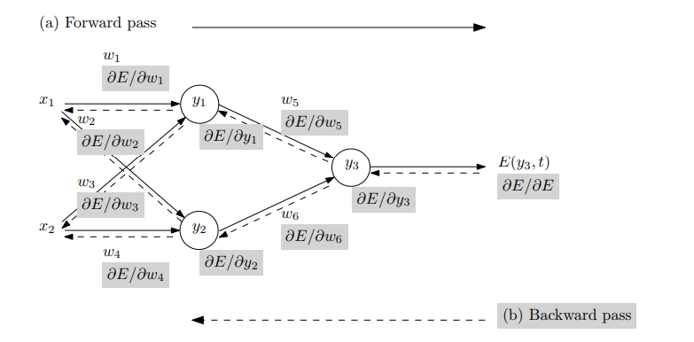
Back Propagation
Efficient method of training with gradient descent
Avoids repeated calculation by exploiting chain rule of differentiation
Introduced in 1986 by Rumelhart et. al.
Figure: Overview of back propagation

Slide 23
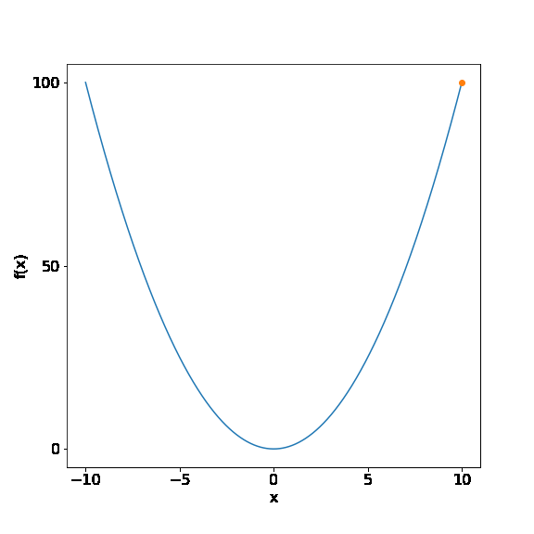
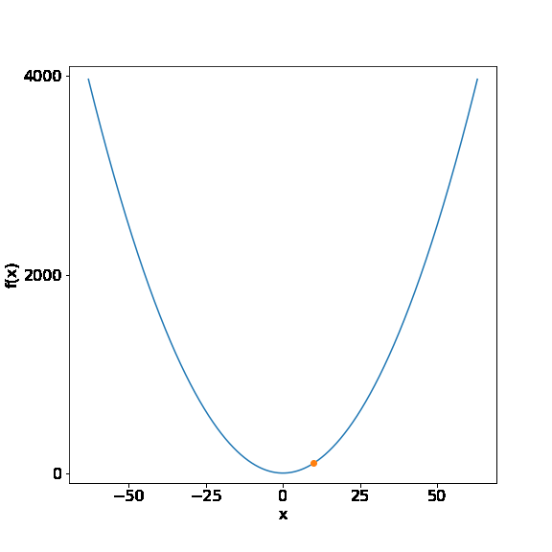
Gradient Descent: Learning Rate
Effects convergence rate
Too low => slow convergence, too high => may diverge
Figure: Effect of learning rate on convergence of a simple quadratic function(left) 0.02 (middle) 0.05 (right) 0.95

Slide 24
Stochastic and Mini-Batch Gradient Descent
In vanilla gradient descent we need to compute gradient for entire dataset
Very slow
Intractable for large dataset
SGD performs a parameter update for each training example
Much faster
Can be trained online(when new data becomes available)
Fluctuates heavily
Mini-batch gradient descent preforms an update for every mini-batch of n training examples
reduces the variance of parameter updates
Can make use of optimized matrix multiplication routine and hardware

Slide 25
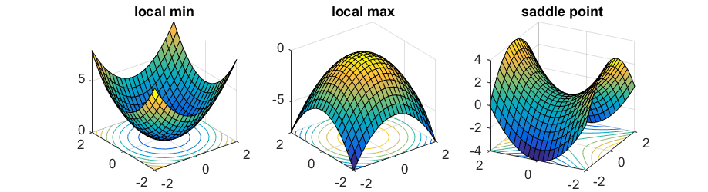
Challenges with mini-batch vanilla gradient descent
Choosing a proper learning rate can be difficult
The same learning rate applies to all parameter updates
It's very difficult for SGD to escape numerous suboptimal local minima especially the saddle points
Figure: Local extrema and saddle points

Slide 26
Gradient Descent Extensions and Variants
Momentum
Nesterov accelerated gradient(NAG)
Adagrad(Adaptive gradient)
RMSprop
Adadelta
Adam(Adaptive Momentum Estimation)

Slide 27
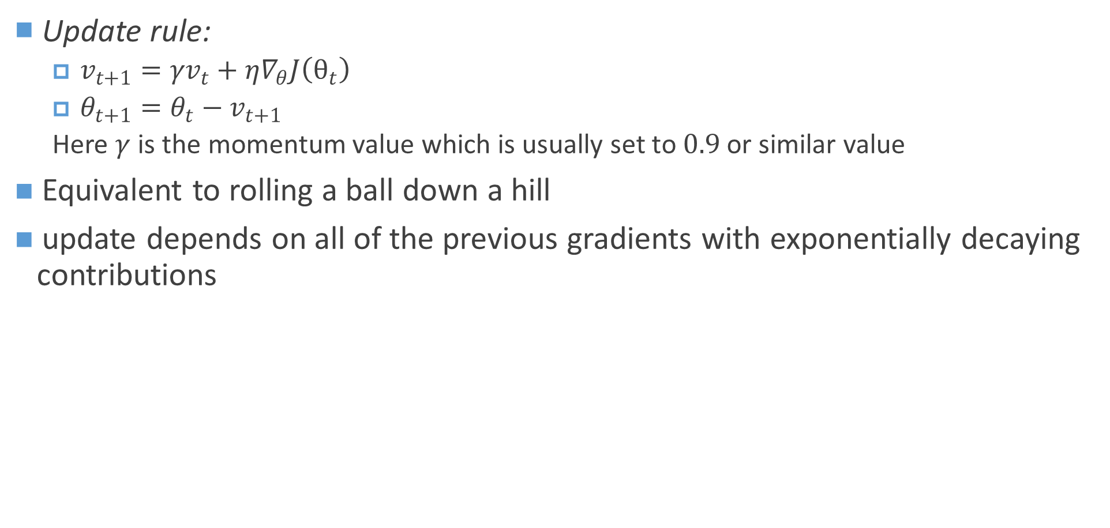
SGD with Momentum
Update rule:
$v_{t+1}={γv}_{t}+η∇_{θ}J\left(θ_{t}\right)$
$θ_{t+1}=θ_{t}−v_{t+1}$
Here $γ$is the momentum value which is usually set to $0.9$ or similar value
Equivalent to rolling a ball down a hill
update depends on all of the previous gradients with exponentially decaying contributions

Slide 28
Adagrad
adapts the learning rate to the parameters, performing larger updates for infrequent and smaller updates for frequent parameters.
Doesn’t require much tuning of learning rate
Adam
Works very well across different tasks
Usually faster convergence

Slide 29
Tasks
Parameter count of a neural network
Plot different activation functions and their derivative
PyTorch Basics
Learn to use different optimizers in PyTorch
Learn to use different loss functions in PyTorch
Autograd in PyTorch

Slide 30
Thank You

Slide 31
Reference
http://www.deeplearningbook.org/contents/mlp.html
http://cs231n.github.io/
https://skymind.ai/wiki/neural-network
https://arxiv.org/abs/1609.04747
https://arxiv.org/pdf/1502.05767.pdf
https://playground.tensorflow.org

